Slide 2
the most confident classifier
I am confident that one of these days, professors will make their exams closed-ChatGPT in addition to closed-book

Slide 3



Ill-posed Problems in ML
There seem to be infinitely many linear classifiers all of which perfectly classify the data! Which one should I choose?
Ill-posed problems can be made “well-posed” by imposing additional requirements on the solution
An example of ill-posed problem from high-school math is a set of linear equations with infinitely many solutions
This means we are dealing with an “ill-posed problem”

Slide 4


Large-margin Classifiers
Such a linear classifier will have a large geometric margin on all training points
Geometric Margin
Small geometric margin
A large geometric margin means a more confident prediction
Let us try to learn a linear classifier which is the most confident on all its predictions

Slide 5
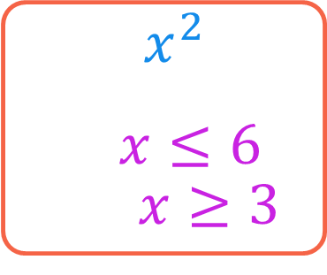
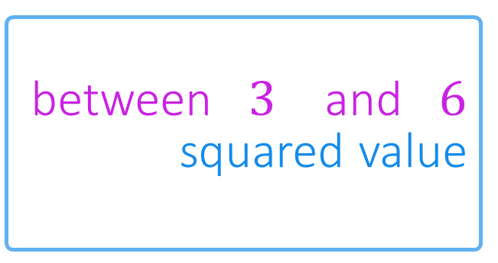
Optimization in ML
The feasible set may be empty in which case the optimization problem has no solution!
Optimization: a branch of math that gives us techniques to search for the “best” object that satisfies certain properties
The object could be a number or a vector etc.
The properties are encoded mathematically as constraints
A function (known as objective function) is used to rate the objects
Just like a set of linear equations that has no solution
Objective
Find me a number between $3$ and $6$ whose squared value is the smallest
$\min_{x}{x^{2}}$
s.t. $x≤6$ and $x≥3$
Feasible Set
Constraints
3 6

Slide 6


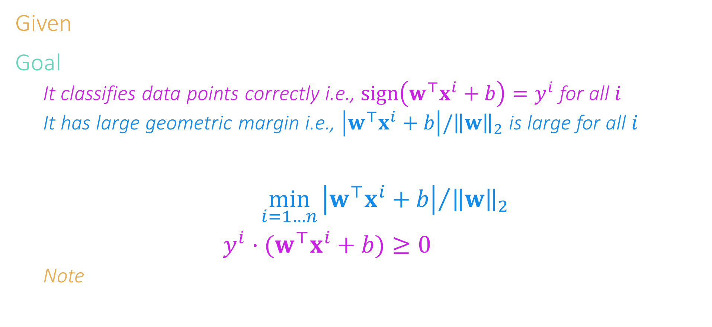
Learning the most confident classifier
We maximize the minimum margin since want every data point to have a large margin
Certain optimization problems choose to maximize their objective function, others choose to minimize them
Given: train data ${\left\{\left(x^{i},y^{i}\right)\right\}}_{i=1}^{n}$ with $x^{i}∈ℝ^{d}$ and $y^{i}∈\left\{−1,1\right\}$
Goal: learn a linear classifier $\left(w,b\right)$ so that
It classifies data points correctly i.e., $sign\left(w^{⊤}x^{i}+b\right)=y^{i}$ for all $i$
It has large geometric margin i.e., $\left|w^{⊤}x^{i}+b\right|/{\left\|w\right\|}_{2}$ is large for all $i$
Thus, correctness becomes our constraint and margin our objective
$\max_{w,b}\left\{\min_{i=1…n}{{\left|w^{⊤}x^{i}+b\right|}/{{\left\|w\right\|}_{2}}}\right\}$
such that $y^{i}⋅(w^{⊤}x^{i}+b)≥0$ for all $i=1…n$
Note: $y^{i}⋅(w^{⊤}x^{i}+b)≥0$ is another way of saying $sign\left(w^{⊤}x^{i}+b\right)=y^{i}$
This optimization problem will fail to give a solution (as feasible set will be empty) if no linear classifier can correctly classify all points We will deal with such cases later

Slide 7

Simplification
Instead of demanding $y^{i}⋅(w^{⊤}x^{i}+b)≥0$, let us instead demand $y^{i}⋅\left(w^{⊤}x^{i}+b\right)≥1$
Simply need to scale the model: if $y^{i}⋅\left(w^{⊤}x^{i}+b\right)≥ε$ for some $ε>0$then if $\tilde{w}≝w/ε$ and $\tilde{b}≝b/ε$ then $y^{i}⋅\left({\tilde{w}}^{⊤}x^{i}+\tilde{b}\right)=1$
Note 1: the scaled classifier makes the same predictions on any point $sign\left(w^{⊤}x+b\right)=sign\left({\tilde{w}}^{⊤}x+\tilde{b}\right) ∀x∈ℝ^{d}$
Note 2: the scaled classifier has the same margin on any point ${\left|w^{⊤}x+b\right|}/{{\left\|w\right\|}_{2}}={\left|{\tilde{w}}^{⊤}x+\tilde{b}\right|}/{{\left\|\tilde{w}\right\|}_{2}} ∀x∈ℝ^{d}$
Turns out, searching for these scaled classifiers is simpler

Slide 8
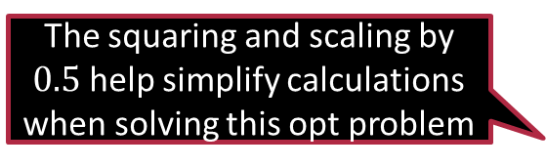

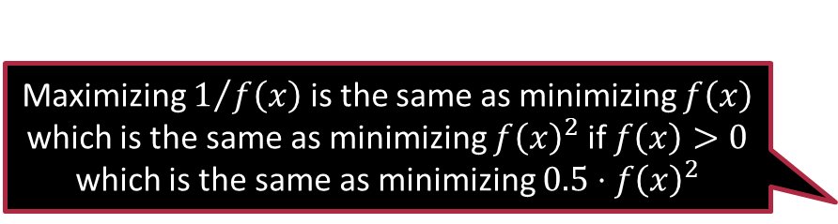
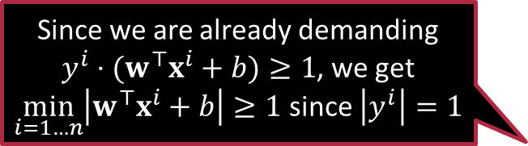
Support Vector Machines
Since we are already demanding $y^{i}⋅(w^{⊤}x^{i}+b)≥1$, we get $\min_{i=1…n}\left|w^{⊤}x^{i}+b\right|≥1$ since $\left|y^{i}\right|=1$
$\max_{w,b}\left\{\min_{i=1…n}{{\left|w^{⊤}x^{i}+b\right|}/{{\left\|w\right\|}_{2}}}\right\}$
such that $y^{i}⋅(w^{⊤}x^{i}+b)≥1$ for all $i=1…n$
$⇓$
$\max_{w,b}\left\{\min_{i=1…n}{1/{{\left\|w\right\|}_{2}}}\right\}$
such that $y^{i}⋅(w^{⊤}x^{i}+b)≥1$ for all $i=1…n$
$⇓$
$\min_{w,b}{\frac{1}{2}{\left\|w\right\|}_{2}^{2}}$
such that $y^{i}⋅(w^{⊤}x^{i}+b)≥1$ for all $i=1…n$
Maximizing $1/{f\left(x\right)}$ is the same as minimizing $f\left(x\right)$ which is the same as minimizing $f{\left(x\right)}^{2}$ if $f\left(x\right)>0$ which is the same as minimizing $0.5⋅f{\left(x\right)}^{2}$
The classifier returned by solving this optimization problem is called the SVM classifier
The squaring and scaling by $0.5$ help simplify calculations when solving this opt problem

Slide 9

Handling Non-separable Data
We suspect that although a good linear classifier exists, it may still not classify every point correctly
For certain points, we may have $y^{i}⋅\left(w^{⊤}x^{i}+b\right)<0$ i.e. $sign\left(w^{⊤}x^{i}+b\right)≠y^{i}$
Problem is, we do not know which points will get misclassified
Slack variables: allow points to get misclassified or else classified correctly but with small geometric margin $y^{i}⋅\left(w^{⊤}x^{i}+b\right)≥1−ξ_{i}$
Extract a price from model for using slack variables
What prevents me from misusing the slack variables to learn a useless classifier that misclassifies every data point?

Slide 10

The C-SVM
$\min_{w,b,\left\{ξ_{i}\right\}}{{\frac{1}{2}\left\|w\right\|}_{2}^{2}+C\sum_{i=1}^{n}{ξ_{i}}}$
s.t. $y^{i}⋅\left(w^{⊤}x^{i}+b\right)≥1−ξ_{i}$ for all $i∈\left[n\right]$
as well as $ξ_{i}≥0$ for all $i∈\left[n\right]$
The constraints $ξ_{i}≥0$ prevent slack variables from being misused to artificially inflate the margin
The $C$ term in the objective prevents the procedure from returning a model that misuses or overuses slack variables
Setting $C$ to a large value will encourage solutions where slack is mostly $0$

Slide 11

Exercise
Find the solution to the following optimization problem $\min_{w,b,\left\{ξ_{i}\right\}}{{\frac{1}{2}\left\|w\right\|}_{2}^{2}}$ $\text{s}\text{.}\text{t}\text{. }y^{i}⋅\left(w^{⊤}x^{i}+b\right)≥1−ξ_{i} \text{for} \text{all} i∈\left[n\right]$ $\text{as} \text{well} \text{as} ξ_{i}≥0 \text{for} \text{all} i∈\left[n\right]$
Hint 1: ${\left\|w\right\|}_{2}^{2}≥0$ for any $w$ and ${\left\|w\right\|}_{2}=0$ if and only if $w=0$
Hint 2: You will see that the solution does not depend on $n$ or the data at all!

Slide 12





The Hinge Loss
Let us introduce the positive-part function $${\left[t\right]}_{+}≝\max\left\{t,0\right\}$$
Looks like an inverted ReLU function used in deep learning
If $y^{i}⋅\left(w^{⊤}x^{i}+b\right)≥1$, then don’t need slack at all i.e., $ξ_{i}=0$
The amount of slack we need is precisely $ξ_{i}={\left[1−y^{i}⋅\left(w^{⊤}x^{i}+b\right)\right]}_{+}$
We can rewrite C-SVM as an unconstrained optimization problem $\min_{w,b }{{\frac{1}{2}\left\|w\right\|}_{2}^{2}+C\sum_{i=1}^{n}{{\left[1−y^{i}⋅\left(w^{⊤}x^{i}+b\right)\right]}_{+}}}$
Note: the second term looks like a loss function
This is the hinge loss function $ℓ_{hinge}\left(t\right)≝{\left[1−t\right]}_{+}$ $\min_{w,b }{{\frac{1}{2}\left\|w\right\|}_{2}^{2}+C\sum_{i=1}^{n}{ℓ_{hinge}\left(y^{i}⋅\left(w^{⊤}x^{i}+b\right)\right)}}$
Zero loss if classification correct and $y^{i}⋅\left(w^{⊤}x^{i}+b\right)≥1$
Small loss if classification correct but $y^{i}⋅\left(w^{⊤}x^{i}+b\right)∈\left(0,1\right)$
Large loss if classification is incorrect
$$1$$
$0$ $1$ $t$

Slide 13
Summary
ML models are often learnt by solving optimization problems
The two main ingredients of an optimization problem are the constraints and the objective function
The objective function may be maximized or minimized
Ill-posed problems may have infinitely many solutions
An opt problem may fail to have a solution if its feasible set is empty
Some opt problems may have no constraints (unconstrained)
Example: the C-SVM problem after we introduced hinge loss
There are several techniques to solve optimization problems
In a later discussion we will find the reason behind the name SVM

Slide 14
Have a blast!
Catch-up with you in the next one.

